Slide 1
Refactoring to Async
Arlo Belshee
@arlobelshee
Arlo.Belshee@live.com

Slide 2
1. Clean up.
2. Extract methods to make a template method.
3. Transform code into data, using events/messages/…
4. Verify the bindings.
5. Transform to async tech while maintaining same flows.
6. Refactoring done! Now consider doing some performance fixes while maintaining async nature.

Slide 3
1. Clean up.
2. Extract methods to make a template method.
3. Transform code into data, using events/messages/…
4. Verify the bindings.
5. Transform to async tech while maintaining same flows.
6. Refactoring done! Now consider doing some performance fixes while maintaining async nature.
Mess -> Template Method
Code -> Data
Sync -> Stupid Async
Stop Refactoring! (Stupid -> parallel)

Slide 4

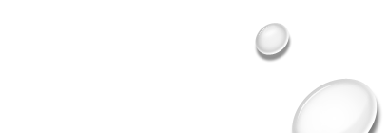
I also teach workshops
Arlo Belshee
@arlobelshee
Arlo.Belshee@live.com

